Slide 1
Business continuity planning (an SMT responsibility)
Iain Pritchard
Adapta Consulting
15 October 2015

Slide 2
About Adapta Consulting
We are:
A specialist information systems consultancy
We only work with membership organisations, charities, associations, trusts and others in the NfP sector
We are completely supplier-independent
Our consultants have held senior positions in a broad range of different organisations
Our advice and guidance is based on practical experience gained over many years.

Slide 3
Purpose of the session
To explore the steps involved in good business continuity planning, including:
Establishing responsibility
Defining the scope
Securing engagement
Identifying risk
Evaluating impact / contingencies
Implementing change

Slide 4
A definitions…
Business Continuity Planning:
“The way in which an organisation plans for future incidents that could jeopardise its core mission and its long-term health”

Slide 5
A Business Continuity Management System
Risk Management
Business Continuity
Prevention
Recovery
Rehearse, maintain and review
Preparedness
Response
Impact Analysis
Crisis Management

Slide 6
A Business Continuity Management System
Risk Management
Business Continuity
Prevention
Recovery
Rehearse, maintain and review
Preparedness
Response
Impact Analysis
Crisis Management

Slide 7
Some example threats
An office becomes inaccessible for a period of time (e.g. due to fire/flood/terrorism), leading to disruption for staff
A business process fails, resulting in the organisation being unable to operate normally for an extended period
An event occurs that damages reputation, leading to complaints and loss of income
Key staff unexpectedly leave or become unavailable, resulting in loss of critical knowledge and know-how

Slide 8
A Business Continuity Management System
Risk Management
Business Continuity
Prevention
Recovery
Rehearse, maintain and review
Preparedness
Response
Impact Analysis
Crisis Management

Slide 9
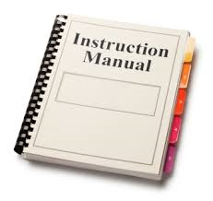
The tangible outputs
Discussion
High-level step instructions
Signposts and references to more detailed documentation
More detailed documentation
Crisis Management and other documents

Slide 10
The project plan
Current
Future
Supplier arrangements
Supplier arrangements
Staff awareness
Staff awareness
Documentation
Documentation

Slide 11
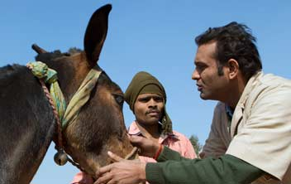
Case study: The Brooke
International animal welfare organisation committed to improving the lives of working horses, donkeys, mules and their owners
£18million
130 staff at the UK office
Regional offices and staff outside the UK

Slide 12
Summary approach
-------- November --------
-------- December -------
----- January -----
The Brooke commissions the review
Meetings and analysis

Slide 13
Step 1: Establishing responsibility
SMT
HODs

Slide 14
Step 2: Defining scope
UK office
Facilities
Technology
UK staff
Staff based in the London office
Home and remote workers
UK staff travelling abroad
UK systems
ICT services (on-premise and hosted)
Third-party service provision

Slide 15
Step 3: Securing engagement
First meeting
Initial proposals from HODs
Draft BCP and plan
------- November -------
-------- December --------
----- January -----

Slide 16
Which risks to focus on?
Step 4: Identifying risk
Probability definitions
Catastrophic | 5 | 10 | 15 | 20 | 25
Major | 4 | 8 | 12 | 16 | 20
Moderate | 3 | 6 | 9 | 12 | 15
Minor | 2 | 4 | 6 | 8 | 10
Insignificant | 1 | 2 | 3 | 4 | 5
 | Remote | Unlikely | Possible | Probable | Highly Probable

Slide 17
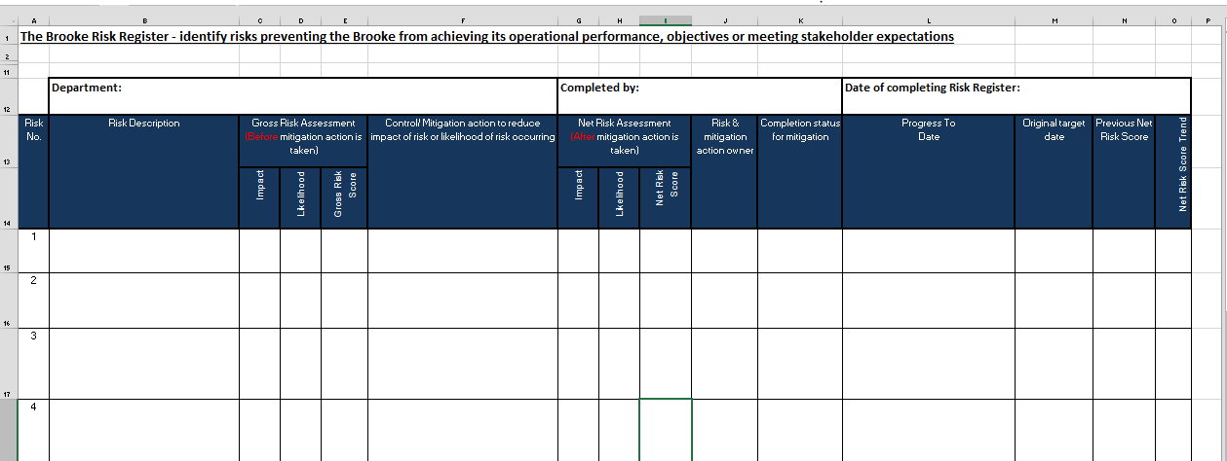
Step 5: Evaluating impact/contingencies

Slide 18
Step 6: Implementing change
Documenting
Training
Inducting
Rehearsing
Managing

Slide 19
An example template
No. | Activity type (Income, Services delivery, or Support) | Description of activity | Potential impact or cost of being unable to carry out the activity
 |  |  | Impact on… | After two weeks | After one month | After one quarter
1 | Income | Example - Collection of payments via direct debit | Processes | Might miss date for collection of DDs and would then have to write to the supporter and collect a double-payment in the following month | Same as after 2 weeks | Unlikely that XYZ organisation would be able to retrospectively claim several months of lost DD payments; would have to accept that one or more DD runs can no longer be carried out
 |  |  | People | Reputational damage; could lose supporters as a result of the inconvenience caused to them Increased queries and/or complaints; some supporters could be confused as to why the payment was taken late Extra work/effort for staff to process back-dated DDs | Same as after 2 weeks | Likely to permanently lose some supporters – estimated at 0.5% overall drop in income
 |  |  | Technology | No impact on systems | No impact on systems | No impact on systems
2 | Remainder of table to be completed by BCP champions (please copy more rows as required to complete the able)… | TBC | Processes | TBC | TBC | TBC
 |  |  | People | TBC | TBC | TBC
 |  |  | Technology | TBC | TBC | TBC

Slide 20
A Business Continuity Management System
Risk Management
Business Continuity
Prevention
Recovery
Engagement, planning and documentation
Preparedness
Response
Impact Analysis
Crisis Management

Slide 21
Questions

Slide 22
Thank you
help@adaptaconsulting.co.uk
www.adaptaconsulting.co.uk
Adapta Consulting, 5 St John’s Lane, London, EC1M 4BH
020 7250 4788

